Slide 1
Spanning tree
</
/>
S&T
DS lvl-2

Slide 2
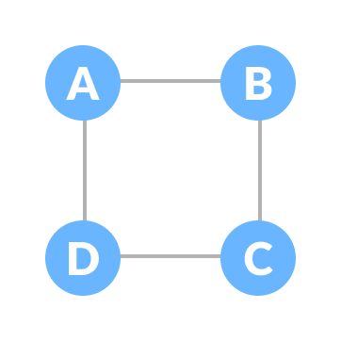
</what’s spanning tree ?
A spanning tree is a sub-graph of an undirected connected graph, which includes all the vertices of the graph with a minimum possible number of edges. If a vertex is missed, then it is not a spanning tree.

Slide 3

</ properites of spanning tree ?
The total number of spanning trees with n vertices that can be created from a complete graph is equal to n^{(n-2)}.
The edges may or may not have weights assigned to them.
Number of spanning trees = |E| C |V – 1| - # cycles
Cycles
Edges = |v| - 1

Slide 4
</ Real life application
1. Network Design (Computer Networks)
Application: Designing efficient computer networks (e.g., LANs, WANs).
The Spanning Tree Protocol (STP) is used in Ethernet networks to create a loop-free topology.
2. Transportation Networks
How Spanning Trees Help:
A spanning tree can represent the most efficient way to connect cities or locations without redundant routes.
It minimizes the total cost (e.g., distance, time, or fuel) while ensuring all locations are connected.
Example: Connecting all major cities in a country with a railway network using the minimum number of tracks.

Slide 5
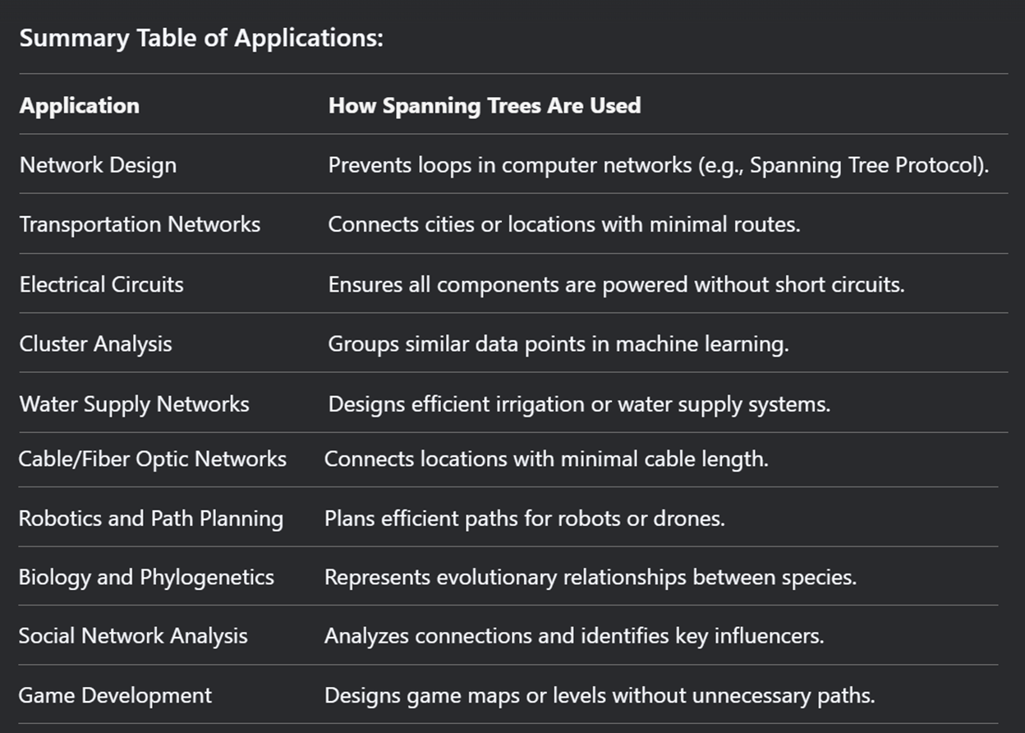

Slide 6
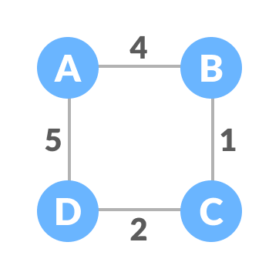
</ Minimum spanning tree (MST)
A minimum spanning tree is a spanning tree in which the sum of the weight of the edges is as minimum as possible.

Slide 7
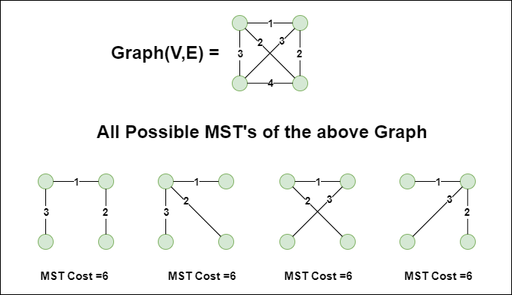

Slide 8
The minimum spanning tree from a graph is found using the following algorithms:
Prim's Algorithm
Kruskal's Algorithm
Boruvka's Algorithm
Reverse-Delete Algorithm

Slide 9
Kruskal's algorithm is a greedy algorithm that builds the MST by sorting all the edges in the graph in increasing order of weight and adding them one by one, ensuring that adding an edge does not form a cycle. It works by considering the edges of the graph. Uses a Union-Find (Disjoint Set Union) data structure to efficiently detect cycles when adding edges.
</ Kruskal's Minimum Spanning Tree
First, it sorts all the edges of the graph by their weights,
Then starts the iterations of finding the spanning tree.
At each iteration, the algorithm adds the next lowest-weight edge one by one, such that the edges picked until now does not form a cycle.

Slide 10
1 – dsu operations 2 – detecting a cycle (undirected graph) 3 – graphical representation 4 – array representation 5 – collapsing find (Path Compression)
</ disjoint set

Slide 11
Prim's algorithm is also a greedy algorithm, but it builds the MST by starting from an arbitrary vertex and adding the smallest edge that connects a vertex in the MST to a vertex outside the MST. It works by considering the vertices of the graph. Uses a priority queue (min-heap) to efficiently find the smallest edge connecting the MST to a new vertex. The priority queue operations take O(logV) time per edge.
</ prims Minimum Spanning Tree

Slide 12
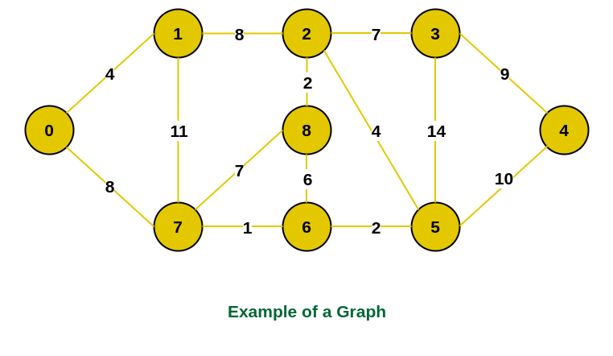

Slide 13
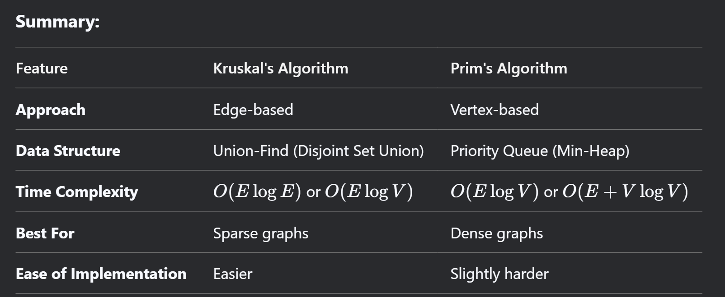

Slide 14
Thank you !
</
/>
Any Questions?

